Slide 1
Why AI Agents Haven’t Worked in Finance,
and What Finally Changed
Glenn Hopper
AFP FP&A Series · Building Financial Intelligence · Sponsored by Ramp
Notes:
Title — Why AI Agents Haven't Worked in Finance, and What Finally Changed
• Finance runs on control; AI runs on probability
• Promise: an agent doing real FP&A work, controls intact
• Vehicle: a 13-week cash forecast, built and governed by an agent

Slide 2
Agenda
1 Why finance said no to AI
2 The rules workaround, and where it breaks
3 What changed: the agent harness
4 Demo: a 13-week cash flow, agent-built
5 Drawing the lines: deterministic, probabilistic, human
6 Where agentic finance is heading
Notes:
Agenda
• Why finance said no to AI
• The rules workaround, and where it breaks
• What changed: the agent harness
• Demo — a 13-week cash flow, agent-built
• Drawing the lines: deterministic, probabilistic, human
• Where agentic finance is heading

Slide 3
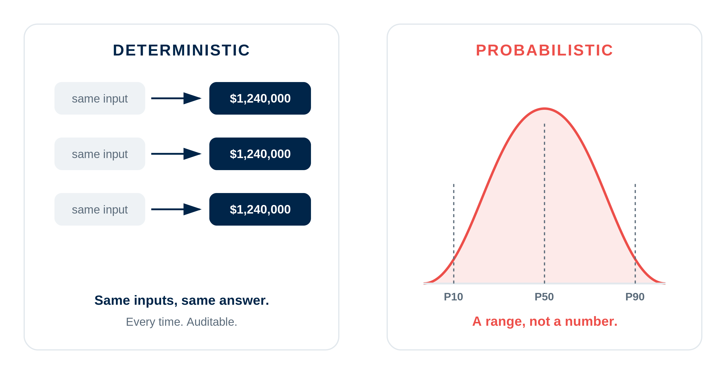
Same inputs. Same answer. Every time.
Notes:
Same inputs. Same answer. Every time.
• Finance is deterministic: same inputs, same output
• Auditors, regulators, boards require repeatability
• LLMs are probabilistic: same prompt, different answers
• That mismatch is why agents stalled in finance

Slide 4

So finance said no.
Finance didn’t reject AI out of stubbornness.
It rejected tools that couldn’t give a repeatable, auditable answer.
A number that changes every run can’t go in front of a board or a lender.
Notes:
So finance said no.
• Not stubbornness — a control problem
• A number that changes each run can't face a board or lender
• No audit trail, no adoption

Slide 5
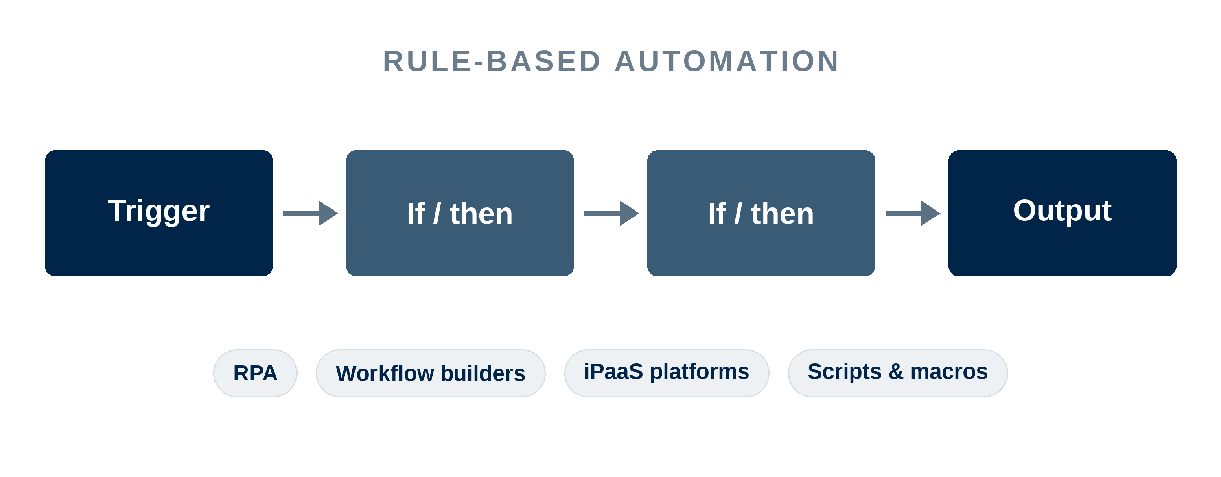
The workaround: rules.
Deterministic, reliable, auditable. If this, then that.
Notes:
The workaround: rules.
• For years the answer was rule-based automation
• RPA, workflow builders, iPaaS platforms, scripts and macros
• Deterministic, repeatable, auditable
• If-this-then-that; gets real work done, still does

Slide 6
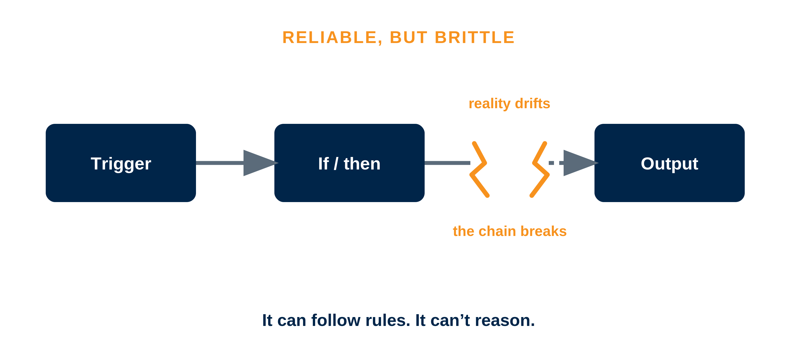
Reliable. Brittle. Can’t reason.
Notes:
Reliable. Brittle. Can't reason.
• Rules break when reality drifts from the flowchart
• Vendor changes a file, a customer pays oddly — chain breaks
• Can automate a task; can't hand it judgment

Slide 7
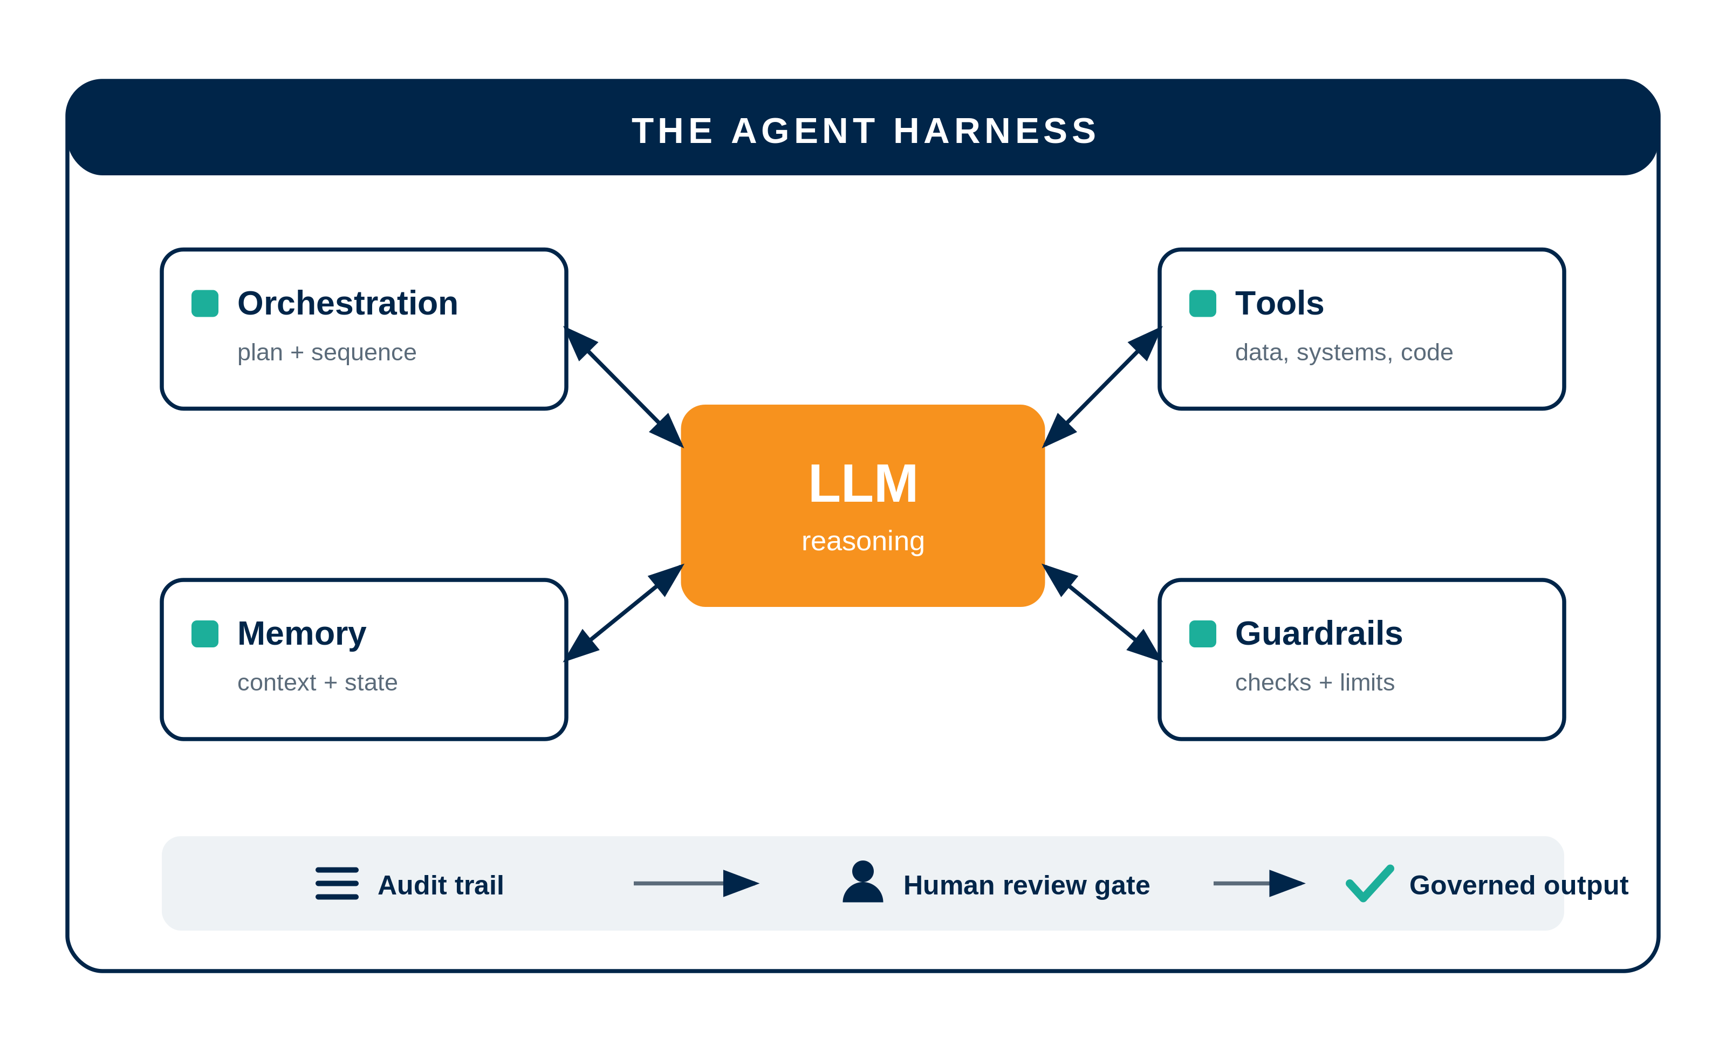
What changed: the agent harness.
The orchestration, tools, memory, and guardrails wrapped around the model.
The model reasons. The harness decides what it can touch and routes judgment to a person.
Notes:
What changed: the agent harness.
• Definition: orchestration + tools + memory + guardrails around the model
• Orchestration plans and sequences; tools reach data, systems, code
• Memory holds context and state; guardrails set checks and limits
• Model reasons; harness decides what it can touch
• It checks its work; routes judgment calls to a human
• Audit trail → human review gate → governed output
• Deterministic control and probabilistic reasoning, together
• This is what makes agents safe enough for finance

Slide 8

Everyone can prompt now.
1B+
people already use AI chatbots.
Prompting isn’t the edge.
Judgment is.
Notes:
Everyone can prompt now.
• 1B+ people already use AI chatbots — prompting is table stakes
• The edge isn't using AI; it's designing where it runs
• Know what to make deterministic, what to leave probabilistic, where humans sit
• That judgment is the differentiator

Slide 9

The case: week one under new owners.
Cascade Precision Products
A PE firm just bought the company.
First ask: a 13-week cash flow forecast.
Contractual certainties meet real uncertainty, on no time.
Notes:
The case: week one under new owners.
• Cascade Precision Products — PE-acquired manufacturer
• New owner's first ask: a 13-week cash flow
• Mixes contractual certainty with real uncertainty
• High stakes, no time — the perfect test

Slide 10
Demo
LIVE HARNESS
https://afp.robocfo.ai/ | p/w: afp2026
Colab notebook + custom cash-flow UI
deterministic ↔ probabilistic · human review gate · audit trail
Notes:
Demo — the harness at work
• Deterministic engine: roll cash forward, week by week
• Flip to probabilistic: one line becomes a P10 / P50 / P90 fan
• Ask it: week-9 cash if collections slip 10 days
• Ask it: which drivers threaten the covenant
• Variance bridge: forecast vs actual, timing vs volume
• Governance on screen: audit trail, tool calls, human review gate
• Show the code once — it's real and reproducible

Slide 11
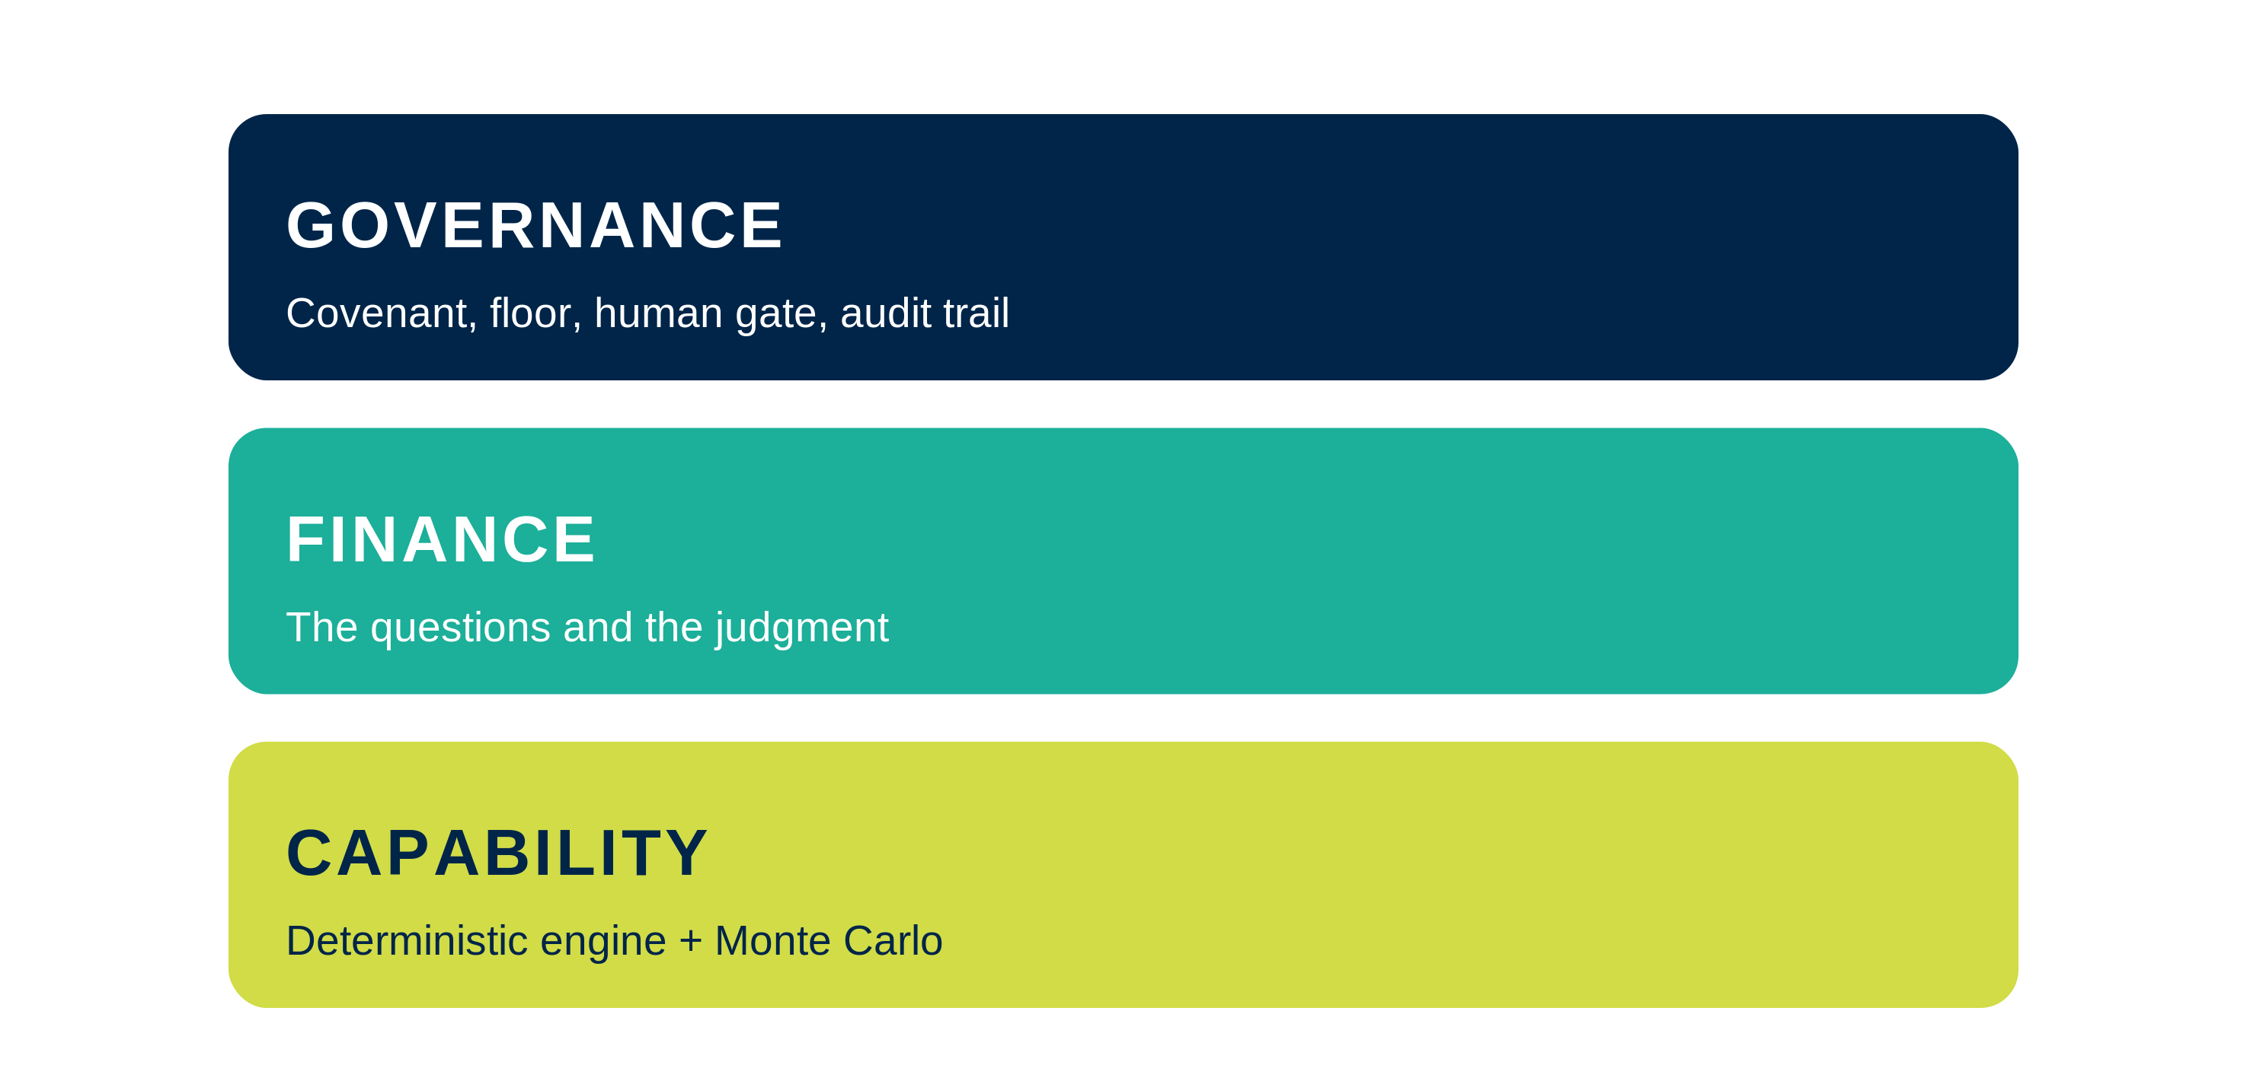
Three layers of a good agent.
Where financial intelligence becomes operational.
The harness embeds finance's judgment and discipline into automated systems.
Notes:
Three layers of a good agent.
• Governance: covenant, cash floor, human gate, audit trail
• Finance: the questions and the judgment
• Capability: the deterministic engine and the Monte Carlo
• The harness is where financial intelligence becomes operational
• It embeds finance's judgment and discipline into the system
• A frame to evaluate any agent, not just this one

Slide 12
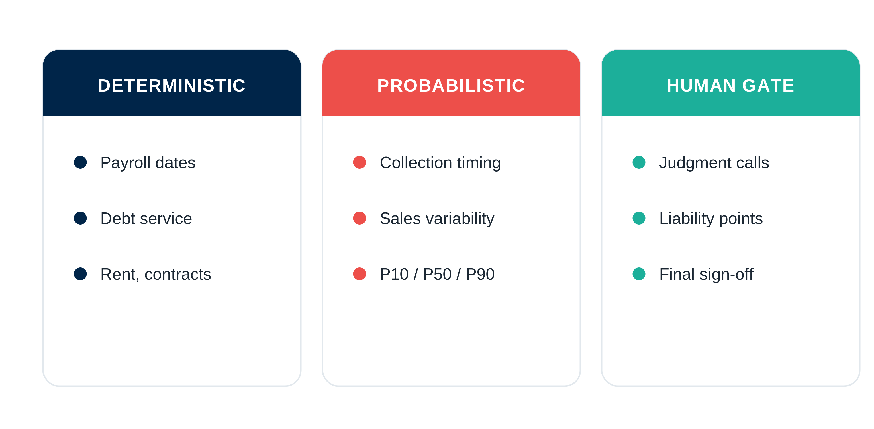
Draw the lines on purpose.
Notes:
Draw the lines on purpose.
• Deterministic controls: contractual or regulated (payroll, debt service, rent)
• Probabilistic methods: genuine uncertainty (collections, sales)
• Human gates: points of judgment and liability
• Lines drawn well = trustworthy; drawn badly = not

Slide 13
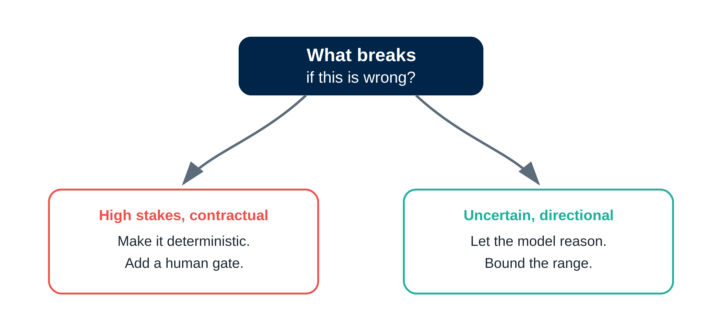
A test you can run on anything.
Notes:
A test you can run on anything.
• Ask: what breaks if this is wrong?
• High stakes and contractual — make it deterministic, add a human gate
• Uncertain and directional — let the model reason, bound the range
• Ports to any workflow, not just cash

Slide 14
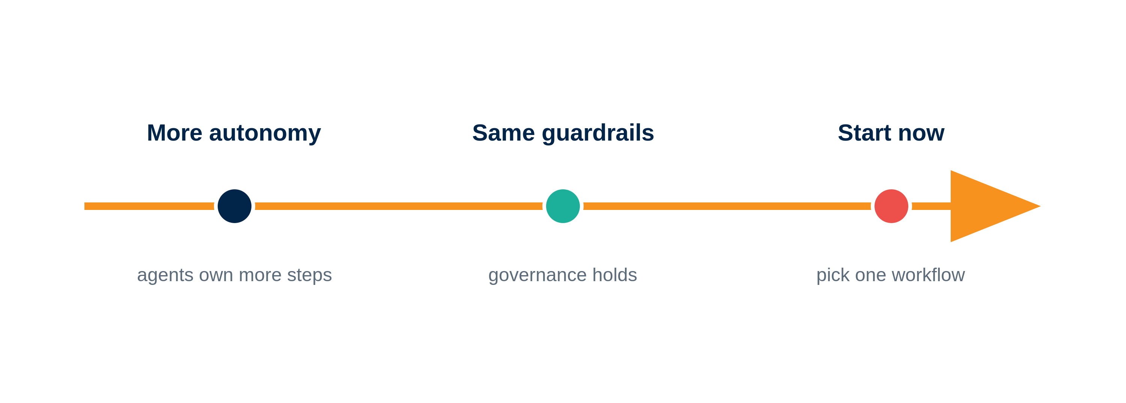
Where this is heading.
Notes:
Where this is heading.
• Agents own more of the steps over time
• Guardrails stay; governance doesn't loosen
• The harness is what lets finance adopt without losing control
• Start now: pick one workflow and draw the lines

Slide 15
Thank you.
Glenn Hopper · RoboCFO.ai
Q&A with Bryan Lapidus, AFP
Notes:
Close and Q&A
• Agents failed in finance because they couldn't be controlled
• The harness is what changed that
• Financial intelligence = knowing where each layer belongs
• robocfo.ai

